Slide 1
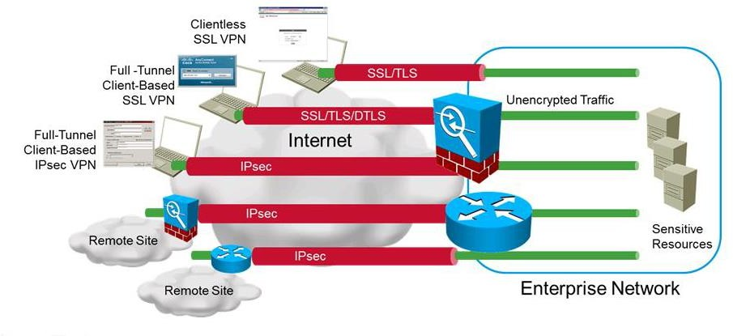
Virtual Private Networks (VPNs):
VPNs are a way to establish private connections over another network.
VPNs protect the data that is transmitted over internet from threats.
Confidentiality | Prevent others from reading data traffic
Integrity | Ensure data traffic has not been modified
Authentication | Prove identity of remote peer and packets
Anti-replay | Prevent replay of encrypted traffic
VPN Support for IOS and ASA Devices:
o The table below lists which types of VPNs are supported on each major device type:
VPN | Cisco IOS | Cisco ASA Firewall
Site-To-Site | Yes | Yes
Remote Access | Yes | Yes
SSL | Yes | Yes
DMVPN | Yes | No
GETVPN | Yes | No
FlexVPN | Yes | No

Slide 2
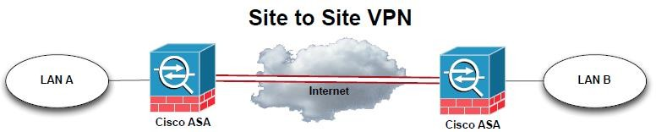
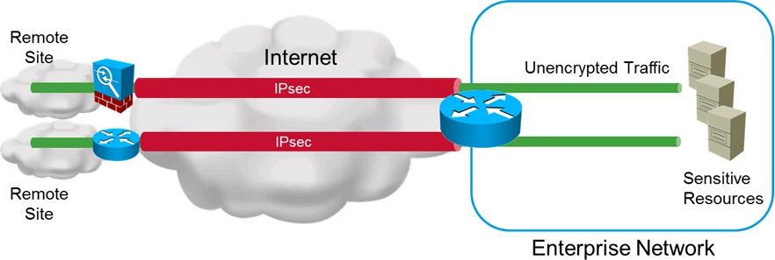
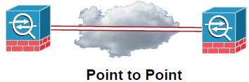
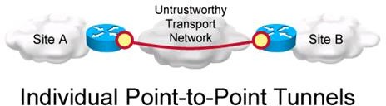
Site-to-Site VPN:
Site-to-Site VPNs are used to connect two or more sites together.
Used instead of private WAN connections or to improve security.
VPN devices may be Cisco routers or Cisco ASA firewalls.
Site-to-Site VPN Utilizes IPSec IKEv1 and IPSec IKEv2 .
They are often used to connect a branch office to the main office
Site-to-Site VPN Supports hub and spoke designs
Site-to-Site VPN Types:

Slide 3
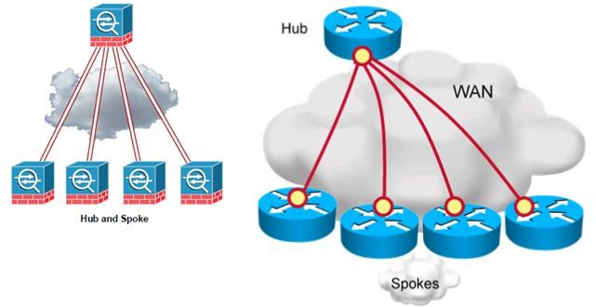
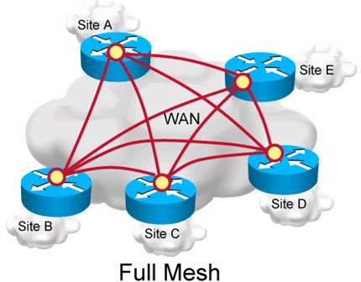

Slide 4
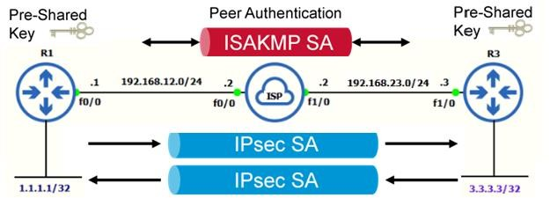
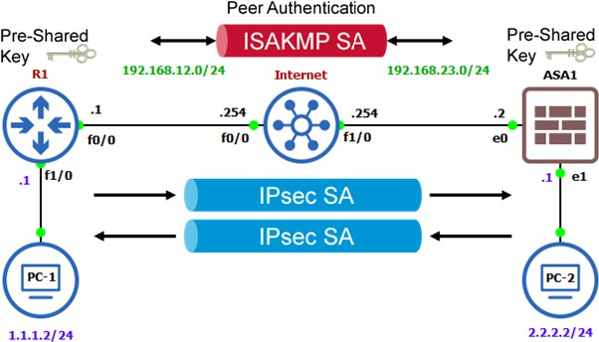
Site-to-Site VPN:
Site to Site VPN With Pre share key with Main Mode.
Site to Site VPN With Pre share key with Aggressive Mode.
o Site to Site VPN With Cisco ASA and Cisco IOS Router.

Slide 5
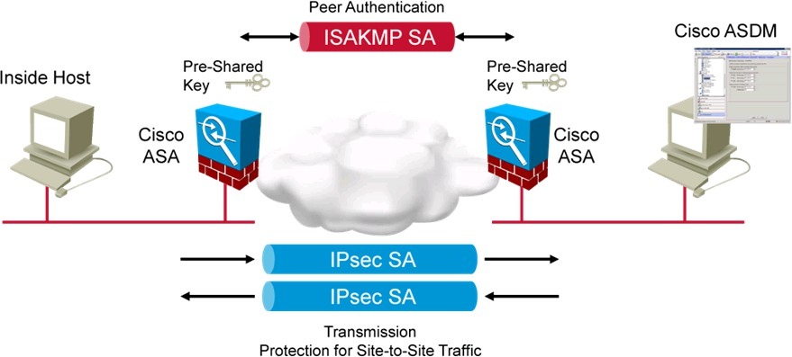
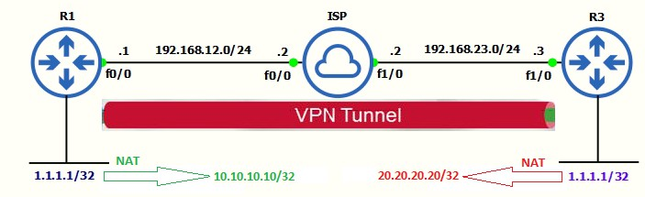
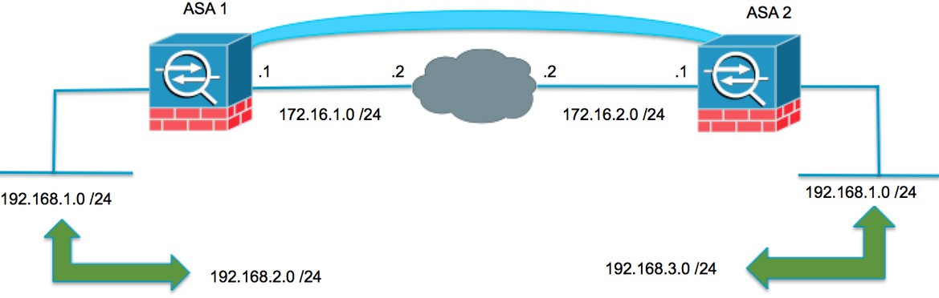
o Site to Site VPN With Pre share key on Cisco ASA Firewalls.
o Site to Site VPN on Cisco IOS Router with Overlapping Subnet.
o Site to Site VPN on Cisco ASA with Overlapping Subnet.

Slide 6
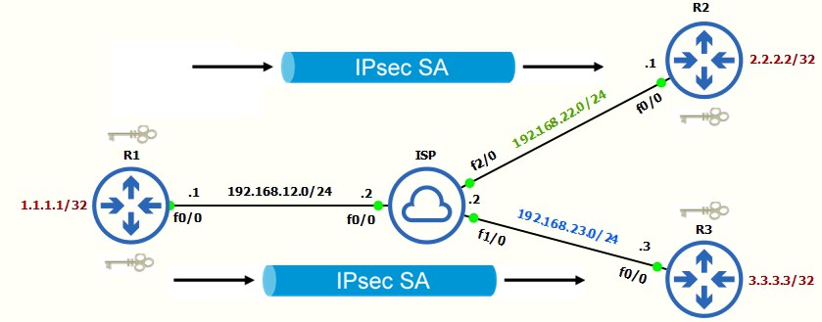
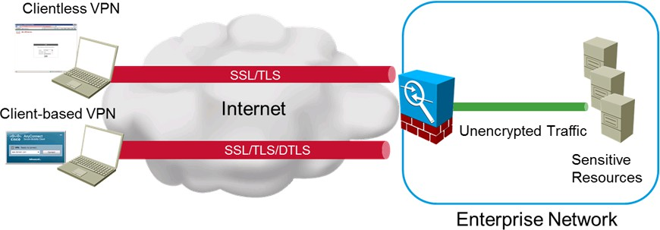
Site to Site VPN on Cisco IOS with CA Server.
Site to Site Hub-to-Spoke VPN on Cisco IOS Router.
Remote Access VPN:
Connects single user to a remote network via gateway such as an ASA.
Utilizes IPsec or Secure Sockets Layer (SSL).
Client-based VPN:
Remote access using client like Cisco AnyConnect.
Permits “full tunnel” access.
Clientless VPN:
Leverages the web browser’s SSL encryption for protection.
Permits limited access but no footprint required.

